Slide 1

RUNGTA COLLEGE OF DENTAL SCIENCES & RESEARCH
TITLE OF THE TOPIC-
ARCH EXPANSION
DEPARTMENT OF ORTHODONTICS AND DENTOFACIAL ORTHOPAEDICS

Slide 2
Specific learning Objectives
CORE AREAS | DOMAIN | CATEGORY
INTRODUCTION | AFFECTIVE | DESIRE TO KNOW
TYPES OF EXPANSION | COGNITIVE | MUST KNOW
INDICATIONS | COGNITIVE | MUST KNOW
RAPID MAXILLARY EXPANSION | PSYCHOMOTOR | NICE TO KNOW
SLOW MAXILLARY EXPANSION | PSYCHOMOTOR | MUST KNOW

Slide 3
CONTENTS
~ Introduction
~ Types : Dental, Skeletal, Passive expansion
~ Indications for Maxillary Expansion
~ Rapid Maxillary Expansion
>> Applied Anatomy
>> Indications
>> Diagnostic aids
>> Effects of RME: Skeletal, On alveolar bone, On anterior&posterior teeth,
On adjacent cranial bones& sutures, On mandible.
~ Types of Appliances Used: Removable& Fixed
~ Activation Schedule: Activation schedule by Timms, Zimring & Issacson
~ Contraindications of RME
~ Retention following RME
~ Clinical tips for RME
~ Slow Expansion
~ Appliances for Slow Expansion
~ Advantages of Slow Expansion
~ Disadvantages of Slow Expansion

Slide 4
INTRODUCTION
An apparently complex yet relatively simple procedure in orthodontics is palatal expansion.
The correction of transverse maxillary deficiency can be an important component of an orthodontic treatment plan.
Expansion of the palate was first achieved by Emerson C. Angell in 1860.
Expansion of the dental arches can be classified as: dental expansion, skeletal expansion and passive expansion.
They can also be classified broadly as:
1.Rapid expansion
2. Slow expansion

Slide 5
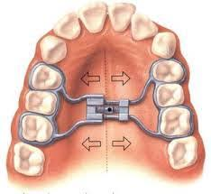
I. Orthodontic or Dental expansion
This type of expansion is produced by various removable expansion plates and conventional fixed appliances.The resultant expansion is dentoalveolar in nature producing primarily a lateral tipping of the crowns and lingual tipping of the roots.

Slide 6
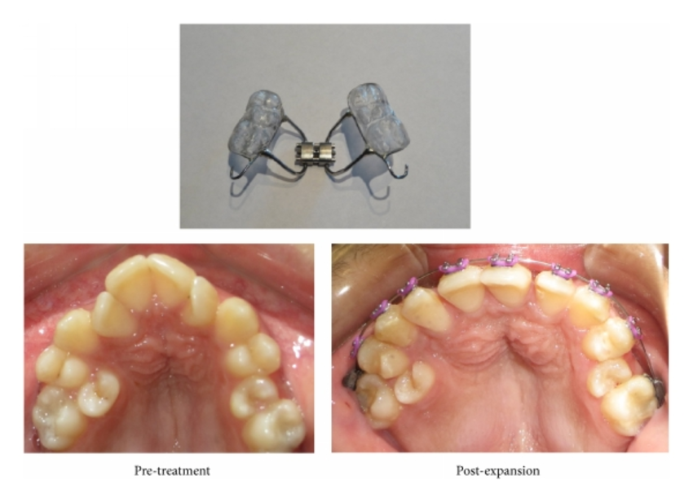
II. Orthopedic or skeletal expansion
In this type of expansion the changes produced are skeletal in nature rather than mere tipping of the teeth bucally.
The example of skeletal expansion is the rapid maxillary expansion.

Slide 7
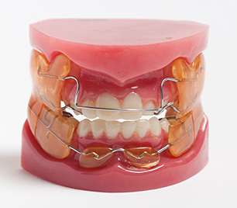
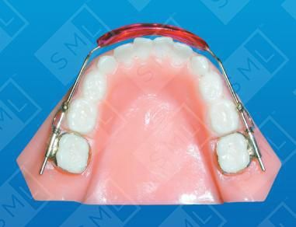
III. Passive expansion
Passive expansion is produced by shielding of the buccal and the labial muscles with a resultant expansion of the arches.Thus this type expansion is not produced by extrinsic forces but rather is a result of intrinsic forces such as produced by the tongue
Example : Fr-2 appliance and lip bumper.

Slide 8
Indications for Maxillary expansion
Cross bite
Mild crowding
Expansion along with Functional appliance treatment
Skeletal class III malocclusion
Distal molar movement
Surgical orthodontics

Slide 9
RAPID MAXILLARY EXPANSION(R.M.E)
Rapid maxillary expansion is also known as rapid palatal expansion or split palate.
It is a skeletal type of expansion that involves the separation of the mid-palatal suture and movement of the maxillary shelves away from each other.

Slide 10
APPLIED ANATOMY
The maxilla together with the palatine bone forms the hard palate,floor and greater part of the lateral walls of the nasal cavity.
The maxilla is a paired bone that articulates various bones including frontal,ethmoid,nasal,lacrimal,vomer,zygomatic and the palatine bones.
The inter-maxillary and the inter-palatine sutures are collectively called the mid-palatal suture.Rapid maxillary expansion should be initiated prior to the ossification of the mid-palatal.

Slide 11
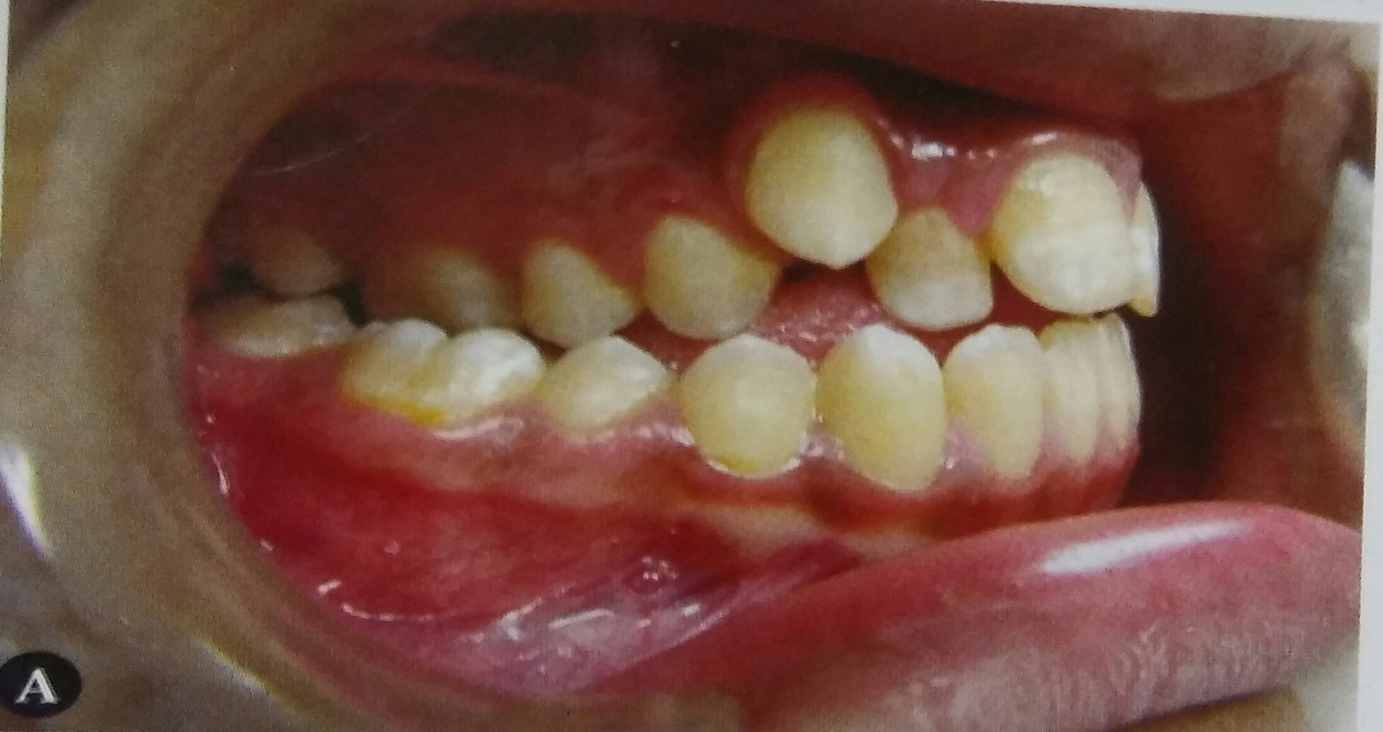
INDICATIONS FOR R.M.E
Posterior crossbite
posterior crossbite associated with real or relative maxillary deficiencies.

Slide 12
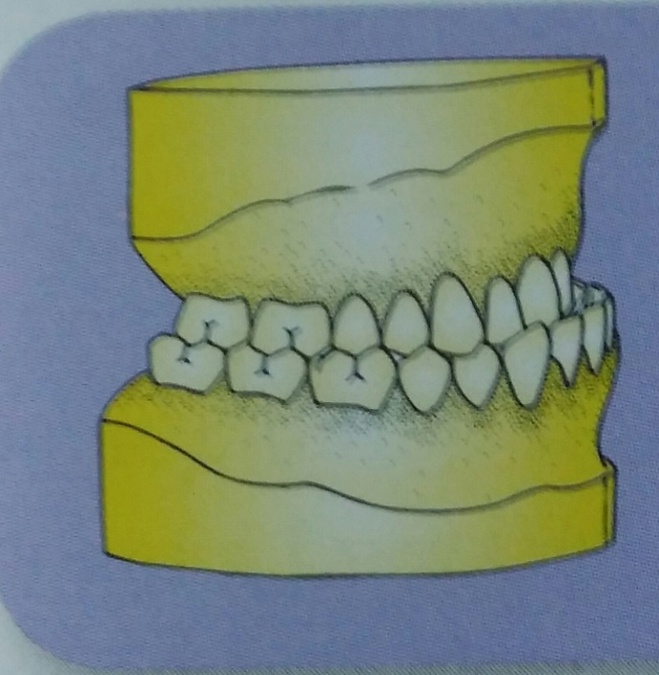

Class III malocclusion
Class III malocclusion of dental or skeletal cause. Improvement is seen in both anterior as well as posterior crossbites.
Cleft palate patients
Cleft palate patients with collapsed maxillary arch may benefit from rapid maxillary expansion.

Slide 13
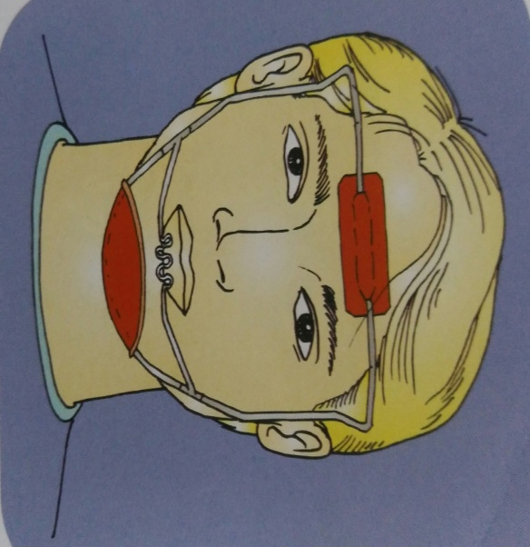
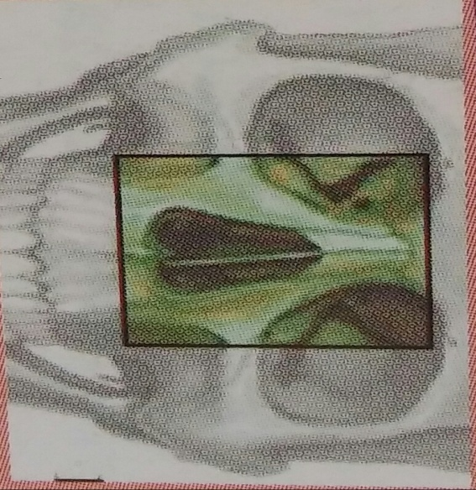
Face mask therapy
In cases requiring face mask therapy, R.M.E is used along with face mask to loosen the maxillary sutural attachments so as to facillitate protraction.
Medical indications
The medical indications for rapid maxillary expansion include nasal stenosis , poor nasal airway, septal deformities, recurrent ear and nasal infection and allergic rhintis e.t.c.

Slide 14
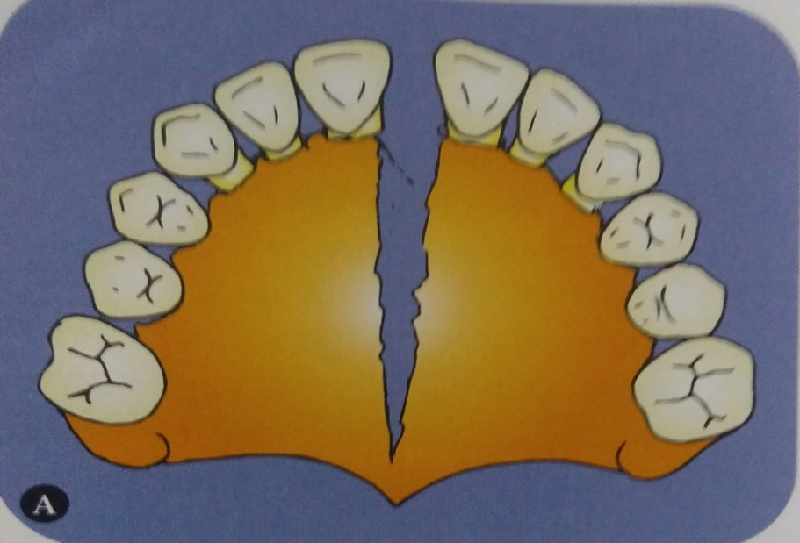
THE EFFECTS OF R.M.E
a. Maxillary skeletal effect:
The maxillary posterior teeth are used as handles to apply a transverse reciprocal force so as to open the mid-palatal suture.
The appliance on activation compress the periodontal ligament and bends the aleolar process bucally and slowly opens the mid-palatal suture.

Slide 15
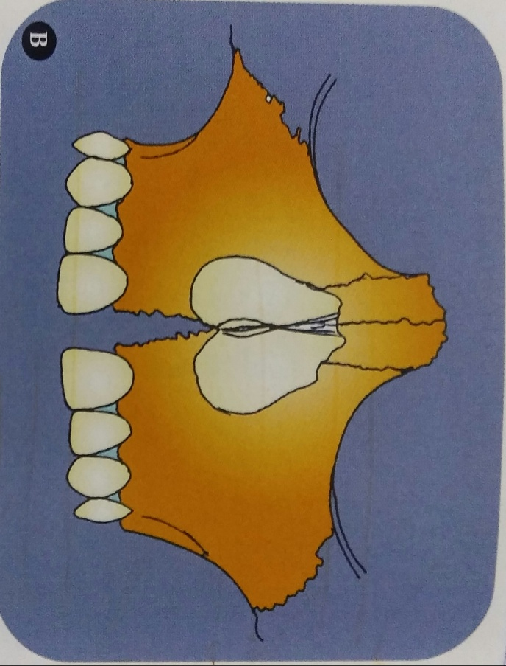
The opening of the mid-palatal suture is fan-shaped or triangular with maximum opening at the incisor region and the gradually diminishing towards the posterior part of palate.
Similar fan-shaped or non-parallel opening is also seen in the superior-inferior direction. The maximum opening is towards the oral cavity with progressively less opening towards the nasal aspect.

Slide 16
b. Effect on alveolar bone
The aleolar bone in the area adjacent to the anchor teeth bends slightly. This is due to the resillient nature of the alveolar bone.
c. Effect on maxillary anterior teeth
The appearance of midline spacing between the two maxillary central incisors is the most reliable clinical evidence of the maxillary separation.

Slide 17
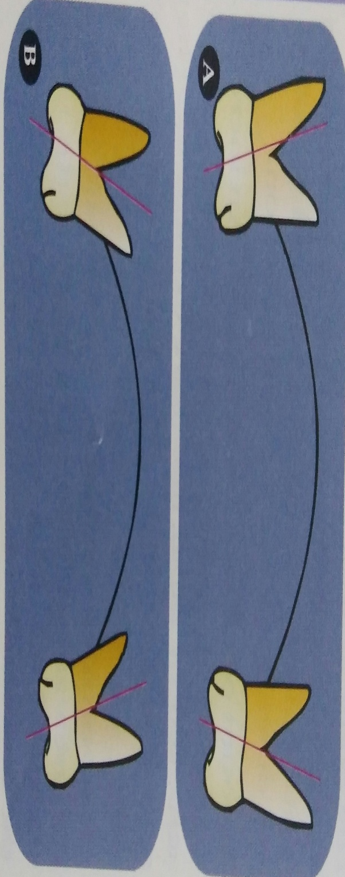
d.Effect on maxillary posterior teeth:
The maxillary posterior teeth are used as anchors during rapid maxillary expansion.These teeth show buccal tipping and are also believed to extrude to a limited extent.

Slide 18
e. Effect on mandible:
Most authors have observed a downward and backward rotation of the mandible following rapid expansion. This is accompanied by a slight increase in the mandibular plane angle.
The reason attributed for the mandibular rotation is the extrusion and buccal tipping of the maxillary molars.

Slide 19
f. Effect on adjacent cranial bones and sutures:
Rapid maxillary expansion not only results in opening of the mid-palatal suture but also has far reaching effects on adjacent cranial structures.
Bones of the cranium such as parietal and occipital were also found to be displaced.

Slide 20
TYPES OF APPLIANCE USED
Classification:
1. Removable appliances
2.Fixed appliances
a. Tooth borne
b. Tooth and tissue borne

Slide 21
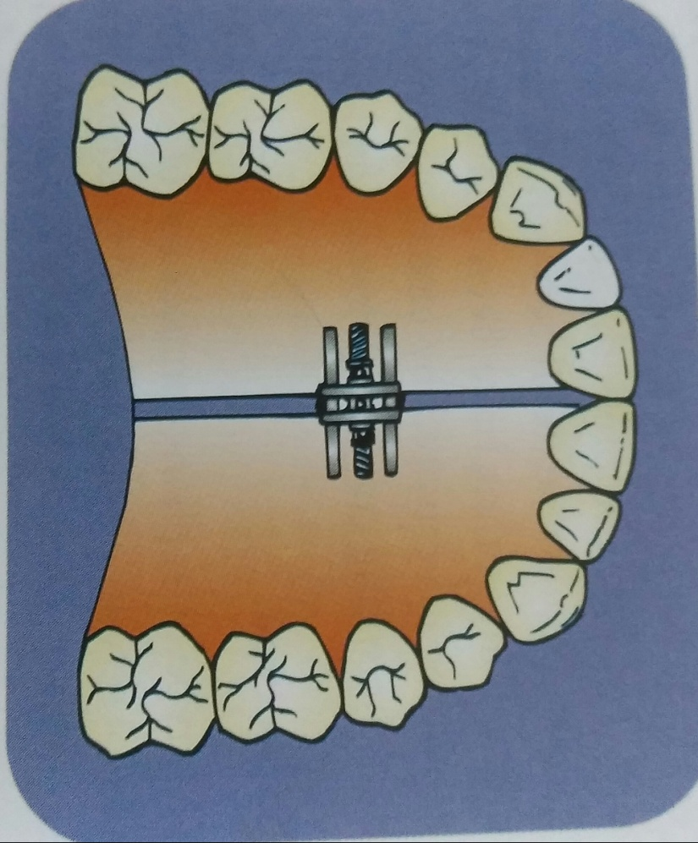
1.REMOVABLE APPLIANCE
The reliability of these appliances in producing skeletal expansion is highly questionable. Although it is possible to split the sutures using removable plates.
A removable type of rapid maxillary expansion device consists of a split acrylic plate with a midline screw.
The appliance is retained using clasp s on the posterior teeth.
A removable appliance are the need for patient co-operation and the difficulty in retaining the plate inside the mouth.

Slide 22
FIXED APPLIANCES
Appliances that are fixed onto the teeth are more reliable and found to produce consistent skeletal effects.
These fixed rapid expanders can be classified into tooth and tissue borne appliances and tooth borne appliances.
Two of the commonly used tooth and tissue borne appliances are:
1. Derichsweiler type
2. Hass type

Slide 23
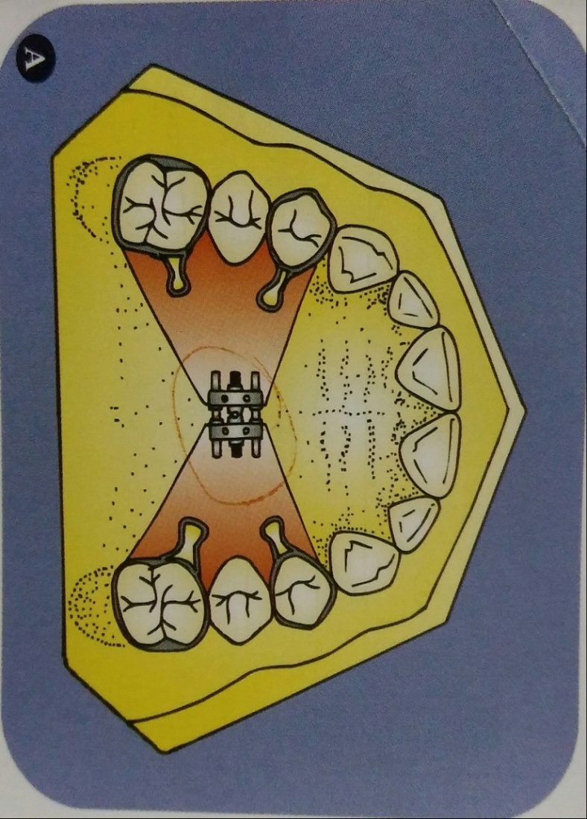
Tooth borne appliances are:
1. Isaacson type
2. Hyrax type
DERICHSWEILER TYPE The first premolar and the first molars are banded. Wire tags are soldered onto the palatal aspect of the bands.
These wire tags get inserted into a split palatal acrylic plate incorporating a screw at its centre.

Slide 24
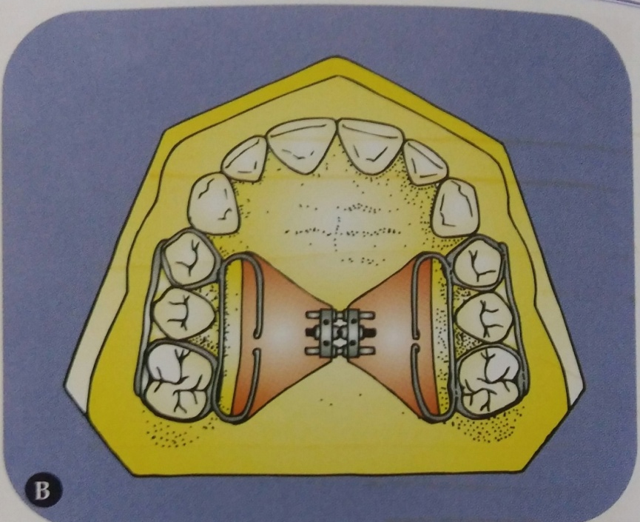
HASS TYPE APPLIANCE
The premolar and molar of either side are banded.
A thick stainless steel wire of 1.2 mm diameter is soldered on the buccal and lingual aspects connecting the premolar and molar bands.
The lingual wire is left longer so as to extend past the bands both anteriorly and posteriorly.
These extensions are bent palatally to get embedded in the palatal acrylic .The split palatal acrylic has a midline screw.
The plate does not extend over the rugae area.

Slide 25
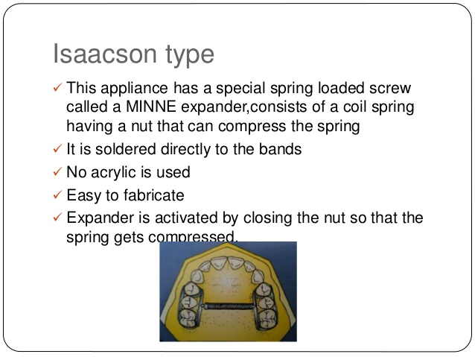
ISAACSON TYPE APPLIANCE
This is a tooth borne appliance without any acrylic palatal covering. This design makes use of a spring-loaded screw called a MINNE expander (developed at the University of Minnesota,Dental School).
The first premolars and molars are banded. Metal flanges are soldered onto the bands on the buccal and lingual sides.
The expander consist of a coil spring having a nut that can compress the spring. This coil spring is made to extend between the lingual metal flanges that have been soldered.
The expander is activated by closing the nut so that the spring gets compressed.

Slide 26
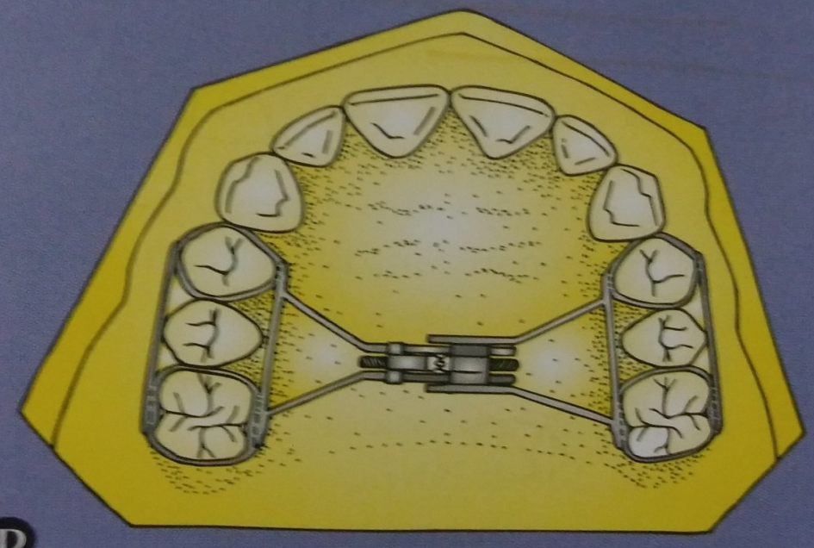
HYRAX TYPE APPLIANCE
This type of appliance makes use of a special type of screw called HYRAX (Hygienic Rapid Expander).
The screws have heavy gauge wire extensions that are adapted to follow the palatal contour and are soldered to bands on premolars and molars.
Types of Hyrax appliance:
a. Banded Hyrax appliance
b. Bonded Hyrax appliance

Slide 27
ACTIVATION SCHEDULE
A. Schedule by Timms:
For patients of up to 15 years of age, 90 degree rotation in the morning and evening. In patient over 15 years, Timms recommends 45 degree activation 4 times a day.

Slide 28
B. Schedule by Zimring and Isaacson
In young growing patients, they recommend two turns each day for 4-5 days and later one turn per day till the desired expansion is achieved.In case non growing adult patients, they recommend two turns each day for first two days,one turn per day foe the next 5- days and one turn every alternate day till desired expansion is achieved.

Slide 29
CONTRAINDICATIONS OF R.M.E
Some cases where R.M.E is contraindicated are:
Single tooth cross bite.
In patients who are un-cooperative, R.M.E is contraindicated, as the appliance requires frequent activation and maintenance of good oral hygiene.
Rapid maxillary expansion is not carried out after ossification of the mid-palatal suture unless it is accompanied by adjunctive surgical procedures.

Slide 30
Skeletal asymmetry of maxilla and mandible and adult cases with severe anteroom-posterior skeletal discrepancies.
Vertical growers with steep mandibular plane angle are usually a contraindication.
As the posterior teeth are used as anchors to move the bones apart, the procedure is not indicated in a periodontally weak dentition.

Slide 31
RETENTION FOLLOWING R.M.E
Failure to retain the expansion results in relapse. Most authors recommend a retention period of not less than 3-6 months.
Isaacson recommend s the use of the R.M.E. appliance itself for the purpose of retention.
The screw should be immobilized using cold cure acrylic. Alternatively, either a removable or fixed retainer(e.g.TPA) can be used.

Slide 32
SLOW EXPANSION
According to the proponents of slow expansion, the results are more stable when the maxillary arch is expanded slowly at a rate of 0.5-1 mm per week.
The forces generated by such procedures are much lower i.e. 2-4 pounds as against 10-20 pounds generated during rapid maxillary expansion.
Slow expansion may take as much as 2-5 months.

Slide 33
APPLIANCES USED FOR SLOW EXPANSION
Removable appliances incorporating jack-screws
Coffin spring
Quad helix
Arch expansion using fixed appliances
Ni-Ti expanders

Slide 34
Coffin spring
This appliance was designed by Walter Coffin around the beginning of this century. It is a removable appliance capable of slow dento-alveolar expansion.
The appliance consists of an omega shaped wire of 1.25 mm thickness, placed in the mid-palatal region.
The free ends of the omega wire are embedded in acrylic covering the slopes of the palate.
The spring is activated by pulling the two sides apart manually.It can also be activated by using three prong pliers.

Slide 35
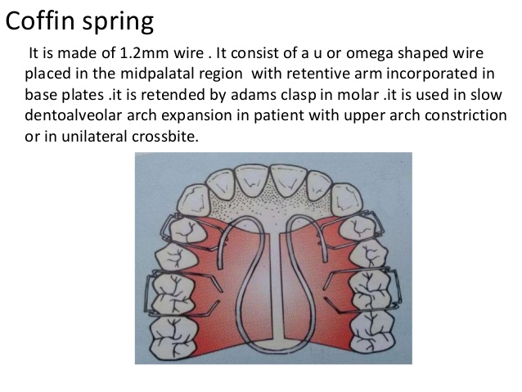
Coffin spring is believed to bring about a dento-alveolar expansion.
However use of this appliance in younger patients is believed to bring about some amount of skeletal expansion.

Slide 36
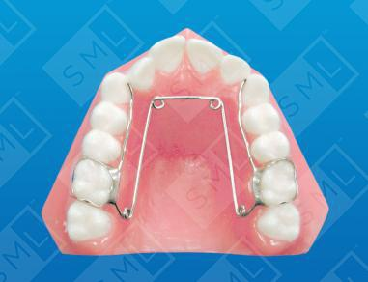
QUAD HELIX
One of the appliance used to expand a narrow maxilla is the quad helix.
It was described by Ricketts, used to expand a narrow maxilla is the quad helix.
The appliance is constructed using 0.038 inch wire and is soldered to bands on the first molars.
The quad helix consists of a pair of anterior helices and a pair of posterior.

Slide 37
The portion of wire between the two anterior helices is called the anterior bridge. The wire between the anterior and the posterior helices is called the palatal bridge.The free wire ends adjacent to the posterior helices are called outer arms.
The quad helix brings about a slow dento-alveolar expansion.But when it is used in children during the deciduous and early mixed dentition periods, a skeletal mid-palatal splitting can be achieved.

Slide 38
ADVANTAGES
Patient compliance not required as it is a fixed appliance.
It is used in conjunction with fixed appliance.
It has got good retention as it is soldered on to bands that are cemented on the molars.
They are inexpensive to fabricate.
Molar rotation and torque is possible.
Can produce limited skeletal expansion when it is used on young individuals.

Slide 39
DISADVANTAGES:
Mostly dental expansion.Limited skeletal expansion.
Molars can tip bucally causing bite to open.

Slide 40
SUMMARY
Any disproportion between tooth and arch dimension predisposes to dental crowding and spacing, which are the most common forms of malocclusions. Thus, the objective of this study was to compare these elements between normal, crowded, and spaced dental arches. (5)We can conclude that the arch widths are less in case of crowding when compared to spacing and they need to be expanded to accommodate all the teeth. Thus , labelling of graph makes it simpler for diagnosing malocclusion and the cases can be treated accordingly.If measured value is less than calculated value, it indicates the need for expansion. Thus, this study helps to determine whether the dental arch is normalor narrow, to determine if transverse expansion is needed & to determine how much expansion is possible using graph labeling. Hence, we conclude that differences in the tooth and arch dimensions are associated with dental arch discrepancies. The size and shape of the teeth & dental arches will have substantial implications in orthodontic diagnosis and treatment planning, affecting the space available, dental esthetics, and stability of the dentition.Thus, these are the important planning factors before orthodontic treatment to determine if arch expansion is needed or not.

Slide 41
REFERENCES
Textbook of Orthodontics – Gurkeerat Singh, Jaypee Brothers; 2nd Edition
Orthodontics – The Art and Science, S.I Bhalajhi, AryaMedi Publishing; 7th Edition
Textbook of Orthodontics – Sridhar Premkumar, Elsevier; 1st Edition
Orthodontics: Diagnosis and Management of Malocclusion and Dentofacial Deformities – O.P Kharbanda, Elsevier; 1st Edition

Slide 42
Question & Answer Session

